Slide 1
Alaska’s Economy and Workforce
Bright spots and persistent challenges
2025 AHHA Legislative Fly-In
February 5
Dan Robinson, Research Chief Alaska Department of Labor and Workforce Development

Slide 2
This Presentation Has Three Parts
Part One

Slide 3
Different Ways to Measure an Economy
How many jobs does it have and is that number growing or shrinking?
What is the value of the goods and services it produces (aka “Gross Domestic Product” or GDP)
Others: personal income, total wages, average wages, unemployment rate, etc.

Slide 4
Alaska and U.S. Job Growth, 1961-2024

Slide 5
Alaska and U.S. Job Growth, 2015-2024

Slide 6
Alaska and U.S. Job Growth, 2015-2024

Slide 7
Alaska and U.S. GDP Growth, 1998-2024

Slide 8
Alaska and U.S. GDP Growth, 1998-2024

Slide 9
In Words Instead of Pictures
Our economy was weaker than the U.S. economy and most other states’ economies from about 2013 to about 2022 (probably our roughest decade since statehood)
For about the last two years, our economy has been slightly stronger than the U.S. economy
It’s not yet clear whether the things that have boosted us (Willow, Pikka, Infrastructure Act) are temporary or will spur longer-term growth

Slide 10
From February’s Issue of Trends:

Slide 11
This Presentation Has Three Parts
Part Two

Slide 12
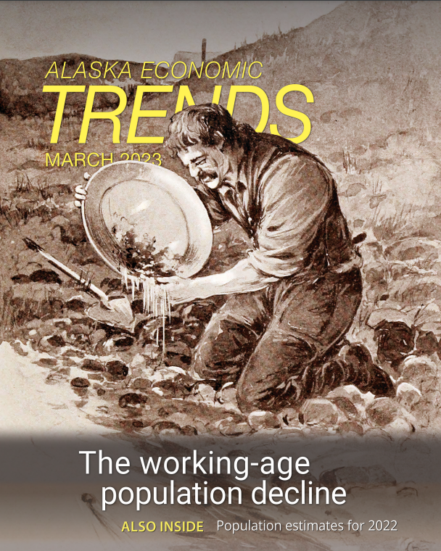
An Ongoing Challenge for Us

Slide 13
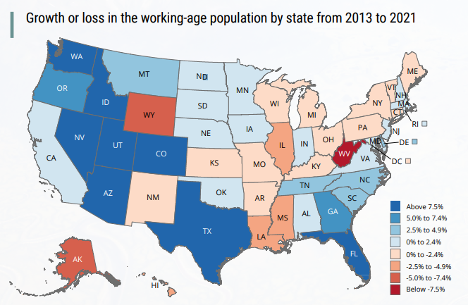
Strong Growth in Most of West, Much of South

Slide 14
The Numbers Through 2024
//

Slide 15
Here’s What’s Mostly Driving That Trend:

Slide 16
The Net of All That Back and Forth

Slide 17
Decisions to Move Are Personal and Varied
Why did you move to Alaska?
What would make you leave?
What do you think has changed in the last decade or so that would make people less interested in moving here or more interested in leaving?

Slide 18
Decisions to Move Are Personal and Varied
Why did you move to Alaska?
What would make you leave?
What do you think has changed in the last decade or so that would make people less interested in moving here or more interested in leaving?

Slide 19
Decisions to Move Are Personal and Varied
Why did you move to Alaska?
What would make you leave?
What do you think has changed in the last decade or so that would make people less interested in moving here or more interested in leaving?

Slide 20
This Presentation Has Three Parts
Part Three

Slide 21
Our Occupational Projections Out to 2032
Every two years we produce long-term (10 years) job projections, and we released a new version in the October 2024 issue of Trends

Slide 22
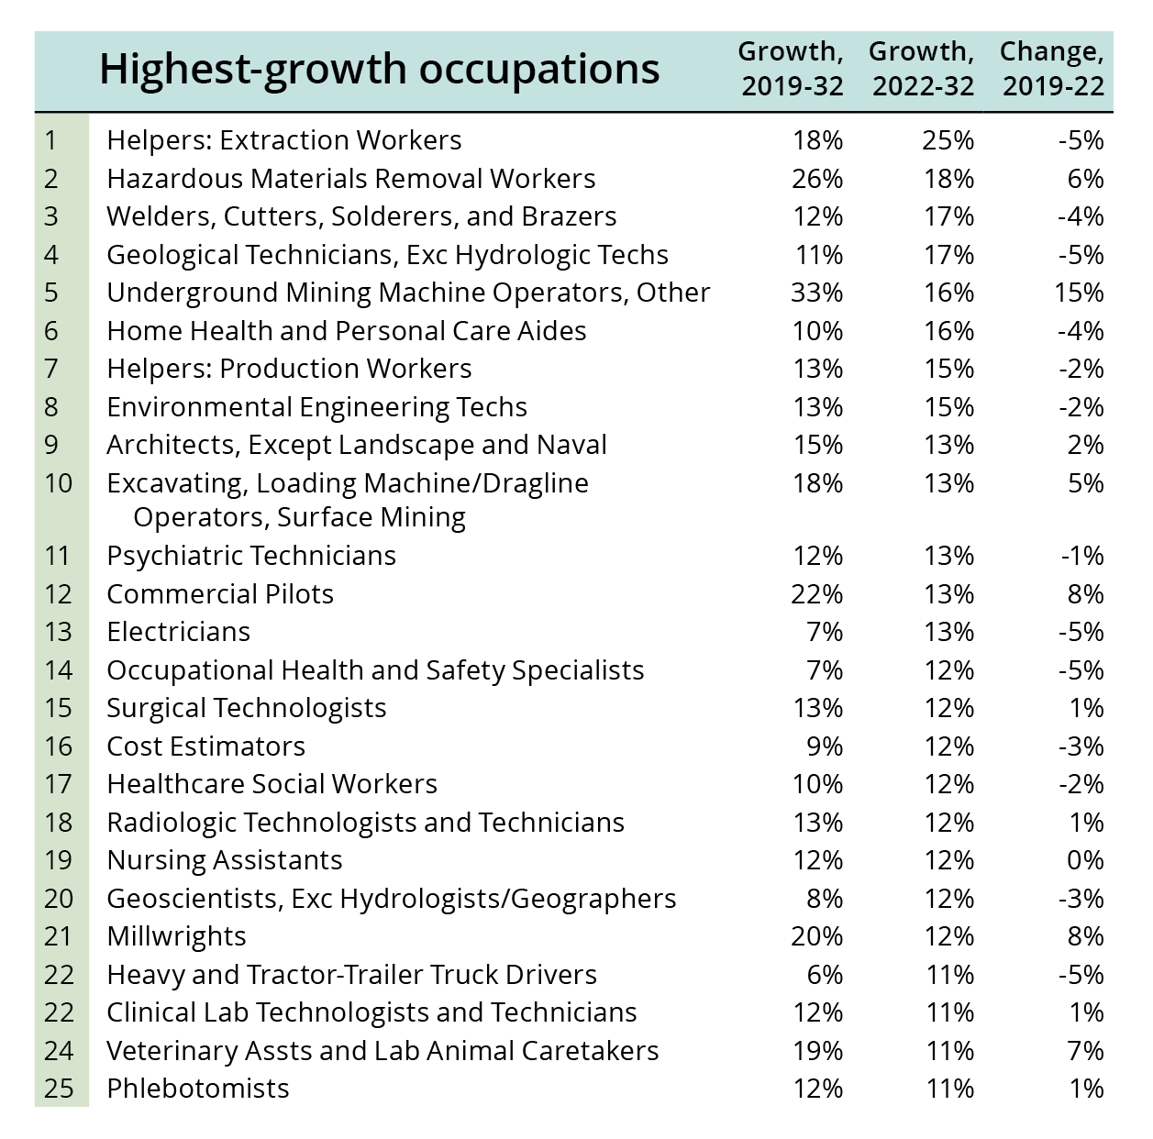
Jobs With Especially Strong Growth
Lots of growth in oil and gas/mining and construction
Related growth in scientific and technical occupations
Health care jobs, though more at the low-wage end (home health, CNAs)
Notes:
These aren’t necessarily the biggest occupations in terms of numbers or the ones that will have the most openings, but the ones projected to grow the most. One interesting thing to add to the bulleted points is that there are actually fewer health care related occupations on this list than in our previous projections.

Slide 23
New(ish) Projections of Skills Most in Demand
Our federal partner, the Bureau of Labor Statistics, recently produced projections of the skills that will be in highest demand over the next decade
Here are some of their findings:

Slide 24
About New Skills-Based Projections
Details and definitions are important, but for jobs that require less than bachelor’s degree, adaptability had the highest skill score followed by problem solving and decision making, and then customer service.
For jobs that require bachelor’s degree or higher, adaptability also had highest score, followed by writing and reading, problem solving and decision making.

Slide 25
About New Skills-Based Projections
Details and definitions are important, but for jobs that require less than bachelor’s degree, adaptability had the highest skill score followed by problem solving and decision making, and then customer service.
For jobs that require bachelor’s degree or higher, adaptability also had highest score, followed by writing and reading, problem solving and decision making.

Slide 26
A Quick Comment About Wages and Retention

Slide 27
A Quick Comment About Wages and Retention
Wages matter (of course they do) and high wages were a big part of what used to attract people to Alaska for work across a wide range of industries
BUT, an MIT analysis of millions of online profiles that identified employees who had recently left their employers found that four factors were at least three times more likely to contribute to attrition than wages and compensation

Slide 28
Four Key Factors in Low Retention of Workers
Toxic work culture
Job insecurity
Failure to distinguish between high performers and low performers when it came to recognition and rewards
High levels of innovation (?!)

Slide 29
Let’s End On This:
“What we focus on is what we can control.”
- Wael Sawan, Shell CEO

Slide 30
Questions or Comments:
Dan.Robinson@Alaska.gov
907-465-6040

