Slide 1
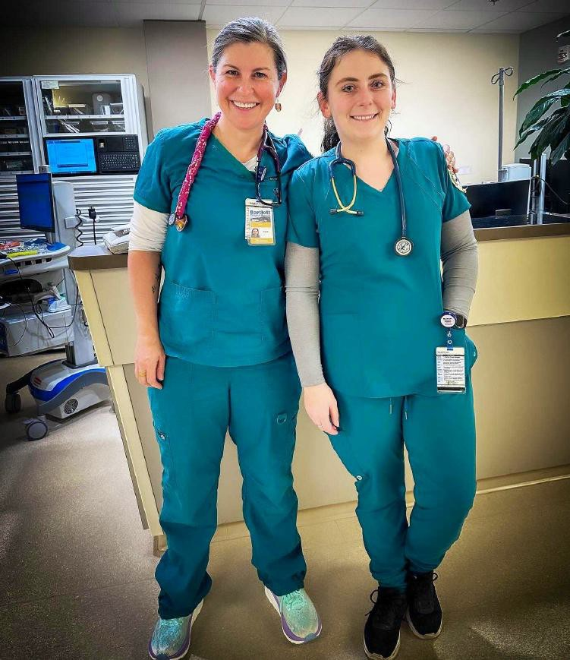
2024
Alaska Healthcare Workforce Analysis
Prepared by
Rain Coast Data

Slide 2
Top 8 Takeaways of
the Alaska Healthcare Workforce Study

Slide 3
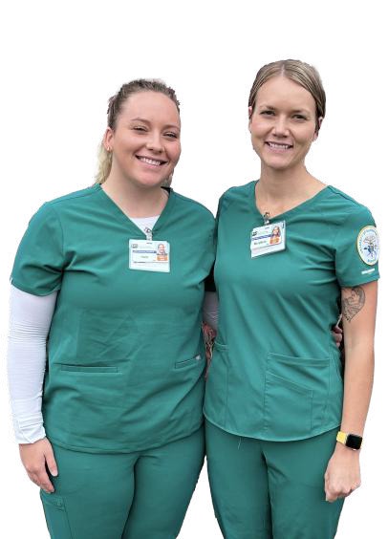
Key Takeaway #₁
Healthcare is Alaska’s #1 economic sector
Healthcare is the most important economic sector in Alaska in terms of employment and wages.

Slide 4
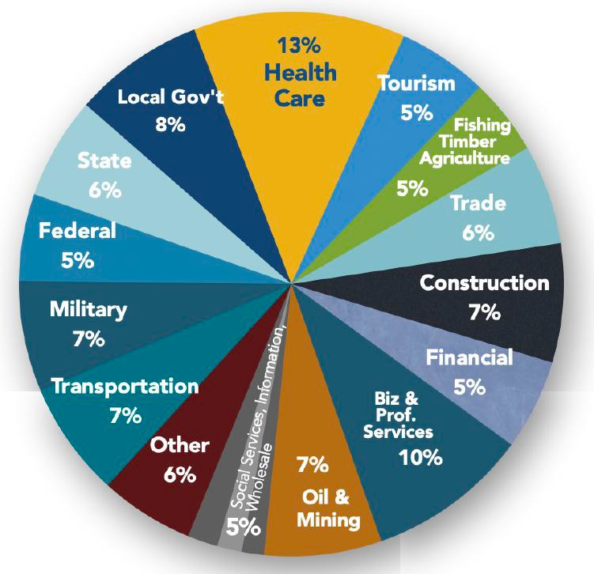
Alaska Workforce Earnings 2023
Workforce earnings in heathcare are higher than any other sector in Alaska
$3.4 billion in direct wages

Slide 5
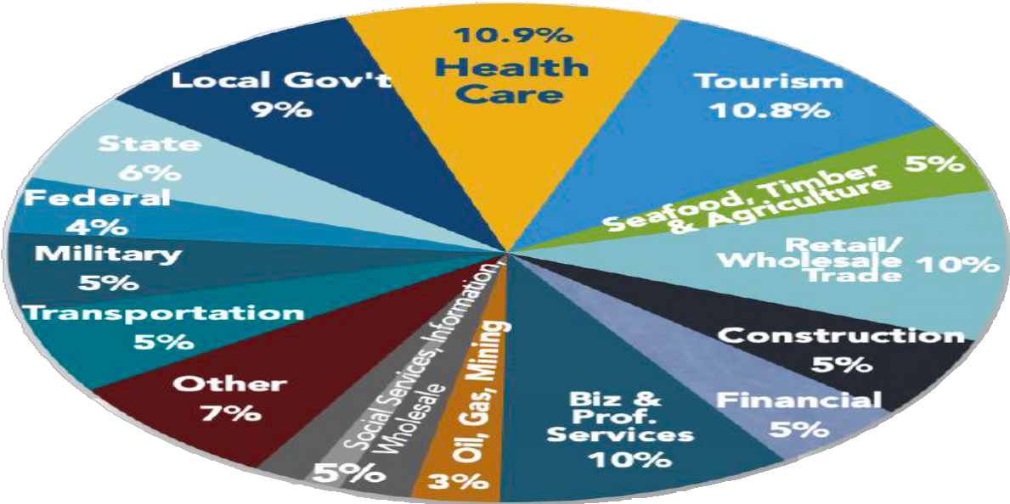
Alaska Workforce 2023 (jobs)
Healthcare is also #1 in employment. Alaska’s healthcare jobs made up 11% of the workforce in the state
44,310 annual average jobs
The US health care industry employed 17+ million people in 2023, making it the largest employment sector in the United States.

Slide 6
And More with Multipliers
Alaska Healthcare Earnings and Jobs Multipliers, 2023
NAICS Code | Category | Sub-type | Annualized Jobs | Employm ent Multiplier | Total Employment Impact | Total Wages | Wages Multiplier | Total Wages Impact
622 | Hospitals |  | 15,881 | 1.8469 | 29,331 | $1,419,930,614 | 1.5102 | $2,144,379,213
623 | Nursing and Residential Care |  | 4,161 | 1.3885 | 5,778 | $177,786,498 | 1.4286 | $253,985,791
6231 |  | Nursing Care Facilities and other Residential Care | 1,413 | 1.4211 | 2,008 | $61,404,932 | 1.4777 | $90,738,068
6232 |  | Residential Mental Disability, Mental Health, & Substance Abuse Facilities | 1,461 | 1.3861 | 2,025 | $68,473,931 | 1.4066 | $96,315,431
6233 |  | Elderly Community Care | 1,287 | 1.2638 | 1,627 | $47,907,635 | 1.3818 | $66,198,770
621 | Out Patient Healthcare |  | 24,268 |  | 40,294 | $1,789,311,764 |  | $2,559,867,092
6211 |  | Offices of Physicians | 8,736 | 1.8896 | 16,508 | $811,348,337 | 1.4288 | $1,159,254,504
6212 |  | Office of Dentists | 2,519 | 1.4714 | 3,706 | $143,314,526 | 1.3731 | $196,785,176
6213 |  | Other Health Practitioners Offices | 4,534 | 1.4076 | 6,382 | $247,212,789 | 1.3786 | $340,807,551
6214 |  | Outpatient Care Centers | 5,331 | 1.7618 | 9,392 | $439,250,463 | 1.4905 | $654,702,815
6215 |  | Medical, Diagnostic Laboratories | 334 | 1.5614 | 522 | $22,407,195 | 1.3892 | $31,128,075
6216 |  | Home Healthcare Services | 2,152 | 1.2606 | 2,713 | $63,796,804 | 1.3465 | $85,902,397
6219 |  | Other Ambulatory Healthcare | 662 | 1.6188 | 1,072 | $61,981,650 | 1.4728 | $91,286,574
 | Total Healthcare Sector |  | 44,310 |  | 75,402 | $3,387,028,876 |  | $4,958,232,096
44,310 in direct jobs=
75K
Jobs
Total healthcare jobs impact
$3.4 billion in direct wages=
$5
billion Total healthcare wages impact

Slide 7
Key Takeaway #₂
Thousands of new
hires needed
annually

Slide 8
Alaska Healthcare Employment
Partly due to growth
(Annualized Jobs)
Change 2016-2023 = +4,275 year-round equivalent jobs
44,310
45,000
42,990 42,918
42,622
42,423
42,820
41,852
40,035
+11%
37,500
2016-2023
+4.5%
+1.8%
+0.9%
-1.3%
+0.9%
+0.2%
+3%
30,000
2016
2017
2018
2019
2020
2021
2022
2023

Slide 9
Partly due to growth
10 year projected growth 2022 to 2032
Home Health and Personal Care Aides Healthcare Support Workers, All Other Healthcare Support Occupations
Surgical Technologists
Healthcare Social Workers Radiologic Technologists and Technicians
Nursing Assistants
Paramedics Clinical Laboratory Technologists and Technicians Other Healthcare Support Occupations
Registered Nurses
Phlebotomists Family Medicine Physicians
Occupational Therapy, Physical Therapist Assistants & Aides
Physicians, All Other Healthcare Diagnosing or Treating Practitioners
Medical Assistants
Healthcare Practitioners and Technical Occupations
Nurse Practitioners Massage Therapists
Health Technologists and Technicians, All Other
Physician Assistants Health Technologists and Technicians
Dental Assistants
Physical Therapists Dentists, General Dental Hygienists
Licensed Practical and Licensed Vocational Nurses
Medical Records Specialists Medical and Health Services Managers Psychiatric Aides/Technicians
Healthcare Practitioners and Technical Workers, All Other
Occupational Therapists Emergency Medical Technicians
Pharmacists
Pharmacy Technicians Speech-Language Pathologists
16%
14%
13%
12%
12%
12%
12%
12%
11%
11%
11%
11%
11%
11%
11%
11%
11%
10%
10%
3,380
10%
10%
10%
Additional healthcare
10%
10%
jobs to be added
10%
10%
10%
10%
10%
10%
10%
in next 10 years through
10%
9%
growth
9%
8%
6%
6%
0%
4%
8%
12%
16%

Slide 10
But also due to turnover
New workers needed annually for replacement
Registered Nurses Nursing Assistants Medical Assistants
Healthcare Support Workers, All Other
Home Health Aides Dental Assistants
Medical and Health Services Managers Medical Records Specialists Physicians, All Other Emergency Medical Technicians
Pharmacy Technicians Physical Therapists Nurse Practitioners Physician Assistants Massage Therapists
Health Technologists and Technicians, All Other
Healthcare Social Workers Family Medicine Physicians
Licensed Practical and Licensed Vocational Nurses
Surgical Technologists Healthcare Practitioners and Technical Workers, All Other
Psychiatric Technicians Dental Hygienists Pharmacists Dentists, General
Medical and Clinical Laboratory Technologists Radiologic Technologists and Technicians
Occupational Therapists Speech-Language Pathologists
1,412
853
777
722
695
429
391
152
148
148
147
134
134
133
130
118
117
111
110
107
106
101
99
93
84
78
78
74
57
9,430
New Alaska
healthcare workers
needed annually
(growth +
replacement)
Needed every year
0
400
800
1,200
1,600

Slide 11
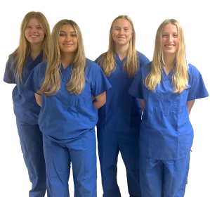
And our pipeline is limited
Alaska Trained Healthcare Workers
Priority Occupations | Reported 2023 | Projected 2024* | Projected 2025 | Projected Need 2025 Due to Growth and Turnover
Registered Nurses | 323 | 373 | 346 | 1,412
Certified Nurse Aide | 392 | 419** | unknown*** | 828
Radiology Technologist | 19 | 15 | 25 | 74
Surgical Technologist | 6 | 12 | 18 | 104
Certified Medical Assistants | 12 | 8 | 11 | 755
Master of Social Work | 31 | 34 | 33 | 113
Respiratory Therapists | 0 | 0 | 0 | 78
Licensed Practical Nurse | 13 | 30 | 43 | 107
Total of Above | 796 | 891 | 880 | 3,471
2025 = 25% of needs filled by new Alaska trained
workers (in 8 key occupations)

Slide 12
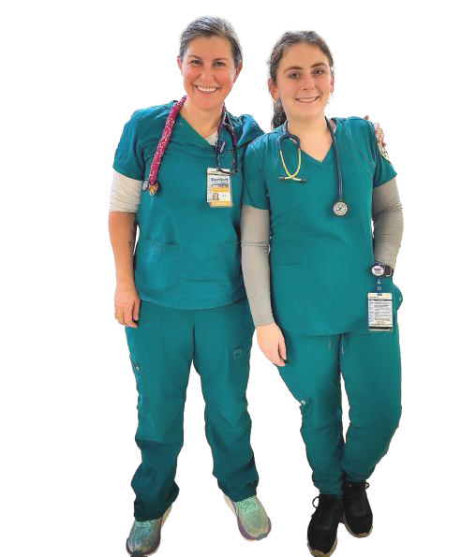
Key Takeaway #₃
High Vacancy Rates

Slide 13
The average vacancy rates for key healthcare positions ranged from 17% to 39% in 2024
22%
Vacancy Rate
for registered nurses
in Alaska’s
Because registered nurses represent the highest workforce need, it can be the most useful single position to track.
In Alaska, hospital registered nurses had an average vacancy rate of 22% in 2024
It took 138 days on average to fill a vacant registered nurse position.
survey of 26 Alaska hospitals, nursing homes and assisted living facilities in 2024 by AHHA
hospitals
138 Days
to fill a vacant RN
position in Alaska

Slide 14
Nursing Nationally
Aging population increases health care demand. By 2050, 23% of the U.S. population will be 65+ (by 2035 in SE)
More than a quarter of RNs say they will retire from nursing over the next 5 years
Nursing school enrollment not growing fast enough to train replacement
Nursing faculty shortage
Burnout and stress level for nurses

Slide 15
Use of traveling healthcare workers is an important tool that the Alaska healthcare industry can use to fill vacant positions
20%
Of AK registered nursing staff are travel RNs
In a survey of 26 Alaska hospitals, nursing homes and assisted living facilities in 2024 by AHHA, organizations reported traveling registered nurses comprise 20% of their RN staff (down from 22% in 2023).
The premium for using traveling nurses was $66 million in Alaska last year.
The ability to operate at a higher capacity due to the contributions of traveling nurses is likely also very valuable for the state’s healthcare providers.
56%
Higher cost of travel nurses compared to staff nurses in Alaska
$66
Million
Excess wages spent using travel nurses last
year

Slide 16
Key Takeaway # ₄
Healthcare
Wages are
Growing

Slide 17
Total Alaska Healthcare Wages
in Billions
47%
$3.39
wage growth in 7 years
$3.16
$2.94
$2.79
$2.69
AK CPI is 22%
$2.43
$2.30
$2.57
+6%
+6%
+5%
+4%
+5%
+8%
+7%
2016
2017
2018
2019
2020
2021
2022
2023

Slide 18
Wage Rankings Among States
Based on an analysis of 62 healthcare positions, Alaska wages are the highest or second highest in 11 categories (was 18).
#1 Highest Wage
Among States
#2 Highest Wage
Among States
#3 Highest Wage
Among States
Healthcare Support Occupations, other Chiropractors
General Internal Medicine Physicians Massage Therapists
Nursing Assistants Ophthalmic Medical Technicians
Healthcare Practitioners and Technical Occupations (all) Emergency Medical Technicians
Magnetic Resonance Imaging Technologists Medical Assistants
Pharmacists
Healthcare Support Occupations (all) Dental Hygienists
Physical Therapists Respiratory Therapists Therapists, All Other
#4 Highest Wage
Among States
#5/#6 Highest Wage
Among States
#7-9 Highest Wage
Among States
Cardiovascular Technologists and Technicians Licensed Practical and Licensed Vocational Nurses
Pharmacy Technicians
Athletic Trainers Dietitians and Nutritionists
Home Health and Personal Care Aides Medical Dosimetrists Pediatricians, General Physician Assistants
Radiologic Technologists and Technicians
Audiologists Dental Assistants Dietetic Technicians
Family Medicine Physicians
Healthcare Practitioners and Technical Occupations Opticians, Dispensing
Paramedics Radiation Therapists Audiologists
Dental Assistants
Registered Nurses
Surgical Technologists

Slide 19
Key Takeaway # ₅
Registered Nurses is #1 Need

Slide 20
Annual Average Jobs
Registered Nurses Home Health and Personal Care Aides
Medical Assistants Nursing Assistants
Medical Records Specialists Medical and Health Services Managers
Dental Assistants Pharmacy Technicians
Health Technologists and Technicians, All Other
Nurse Practitioners Dental Hygienists Physical Therapists
Pharmacists Physician Assistants Family Medicine Physicians Massage Therapists Psychiatric Technicians
Emergency Medical Technicians Occupational Therapists Physicians, All Other Dentists, General
Radiologic Technologists and Technicians Licensed Practical and Licensed Vocational Nurses
Speech-Language Pathologists Surgical Technologists
Diagnostic Medical Sonographers
Psychiatric Aides Healthcare Social Workers
6,590
5,660
2,140
1,710
1,410
1,300
940
860
760
660
610
570
520
510
440
420
410
390
350
350
320
320
320
310
290
270
240
220
15%
Of all AK 44,300
healthcare
workers are registered nurses
0
1,750
3,500
5,250
7,000

Slide 21
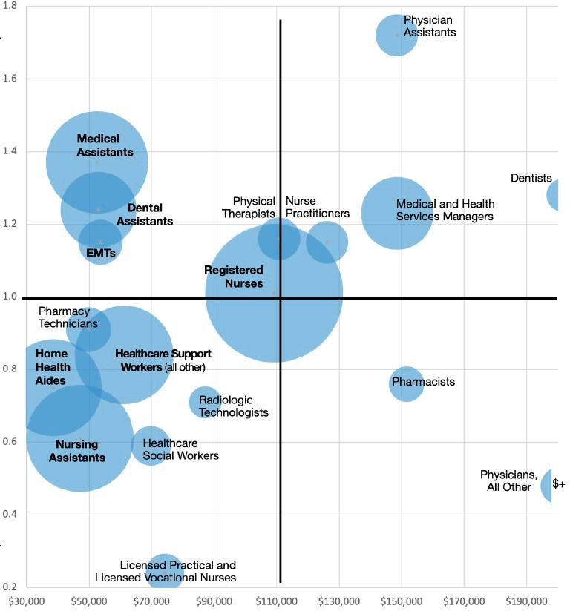
More prevalent in Alaska
Graphic of Health Care Workforce Year Development Needs
Size of
bubble
=
Total workers needed to account for worker churn and job growth
Loca%on Quo%ent
Less prevalent in Alaska
Lowest Paying
Highest Paying

Slide 22
Key Takeaway # 6
Low Nonresidents in Workforce

Slide 23
Share of Nonresidents in Workforce
Alaska Healthcare Sector
13.0%
12.7%
13%
12.1%
11.3%
11.3%
11.7%
11.3%
11.2%
10.3%
10.8%
10.2%
7%
0%
2012
2013
2014
2015
2016
2017
2018
2019
2020
2021
2022

Slide 24
Share of Nonresidents in Workforce
Alaska Healthcare Sector
All Alaska jobs
22%
21%
22% 22%
21%
21%
21%
21%
20%
21%
20%
18%
12%
13%
13%
11%
11%
11%
12%
11%
11%
11% 10%
10%
0%
2012
2013
2014
2015
2016
2017
2018
2019
2020
2021
2022

Slide 25
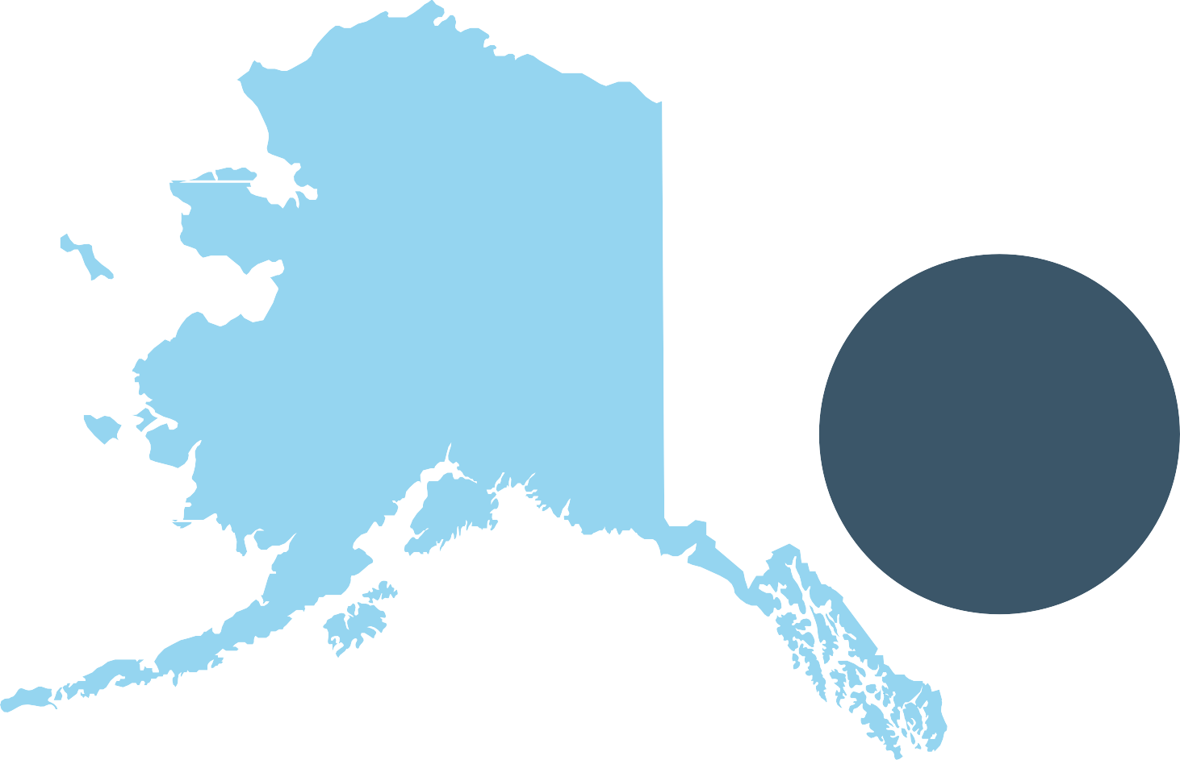
Share of Nonresidents Healthcare Workforce
Northern 22%
Map shows % of nonresident healthcare workforce by region
๏Total Alaska healthcare nonresident workers: 6,144
๏% of Alaska healthcare workforce that are nonresident: 13.5%
๏% of healthcare wages going to nonresidents:
11.2%
๏Average resident healthcare wages:
$69,844
๏Average nonresident healthcare wages:
$85,504
Southwest 19%
Rural Interior 10%
Fairbanks 15%
6,144
Mat-Su 8%
Anchorage 11%
Approximate
nonresident
healthcare
workers in
Alaska
Gulf Coast 13%
Southeast
17%

Slide 26
Share of Nonresidents in AK Workforce
Oﬃce Clerks, General Oﬃce and Administrative Support Workers
Medical Assistants Medical Secretaries and Administrative Assistants
Personal Care Aides Receptionists and Information Clerks Medical and Health Services Managers
Nursing Assistants Billing and Posting Clerks
Dental Hygienists Dental Assistants
Health Care Support Workers, All Other
Home Health Aides Chief Executives Physical Therapists
Maids and Housekeeping Cleaners
Physician Assistants Nurse Practitioners
7%
7%
8%
9%
9%
9%
9%
10%
10%
11%
% Nonresident 2022
21%
Registered
Nurses =
Nonresidents
12%
12%
12%
13%
17%
18%
19%
19%
Registered Nurses
21%
Family Medicine Physicians
26%
26%
0%
6.5%
13%
19.5%

Slide 27
Highest Nonresident Conversion Rate
2021 nonresidents who became residents in 2022
Finance and Insurance Local Government
Retail Trade
30%
27%
26%
Healthcare and Social Assistance
State Government
24%
23%
Wholesale Trade
Utilities Real Estate and Rental and Leasing
Information Admin Support/Waste Mgmt and Remediation Professional, Scientific, and Technical Svcs
Educational Services
Construction
22%
21%
19%
19%
15%
15%
14%
14%
24%
Go on to
Alaska Average
14%
Accommodation and Food Services Arts, Entertainment, and Recreation Transportation and Warehousing Information Agriculture, Forestry, Fishing, Hunting Mining, Quarrying, Oil/Gas Extraction
Manufacturing
13%
become
10%
9%
9%
residents
5%
3%
0%
7.5%
15%
22.5%
30%

Slide 28
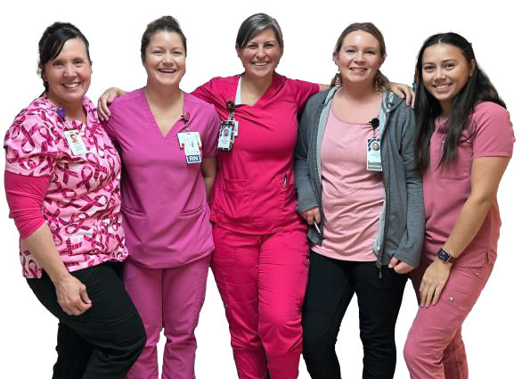
Key Takeaway #₇
Most Healthcare Workers are Women

Slide 29
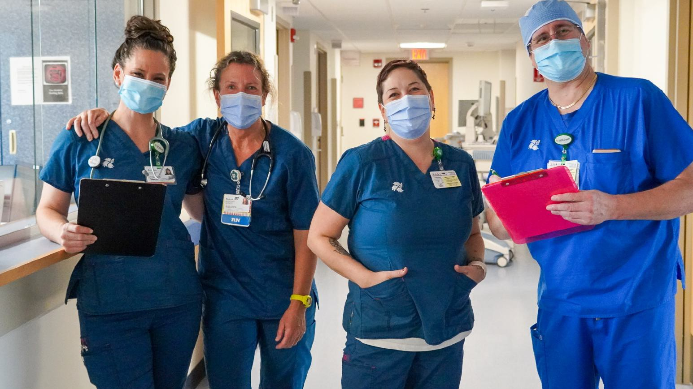
Alaska Female Healthcare Workers 72%
Alaska Male Healthcare Workers 28%

Slide 30
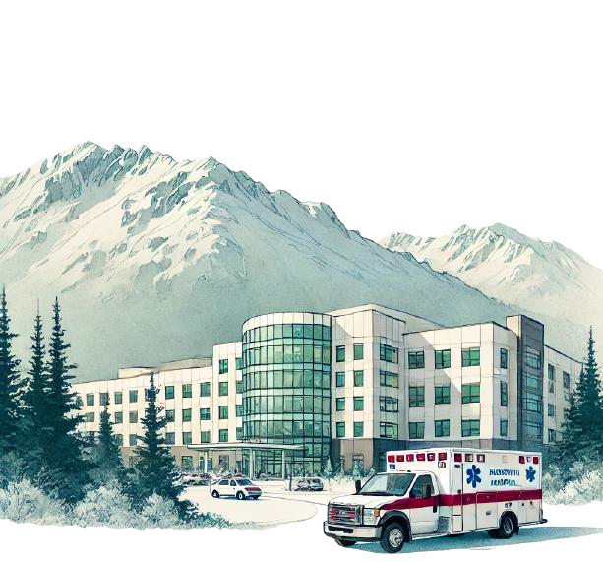
Key Takeaway #₈
Most Healthcare Jobs/Wages in AKs Hospitals

Slide 31
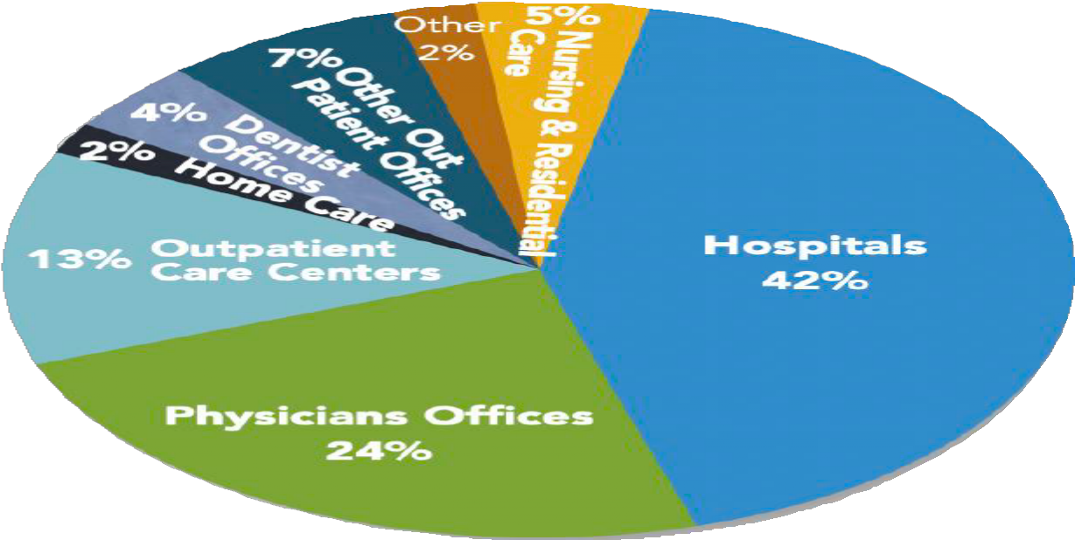
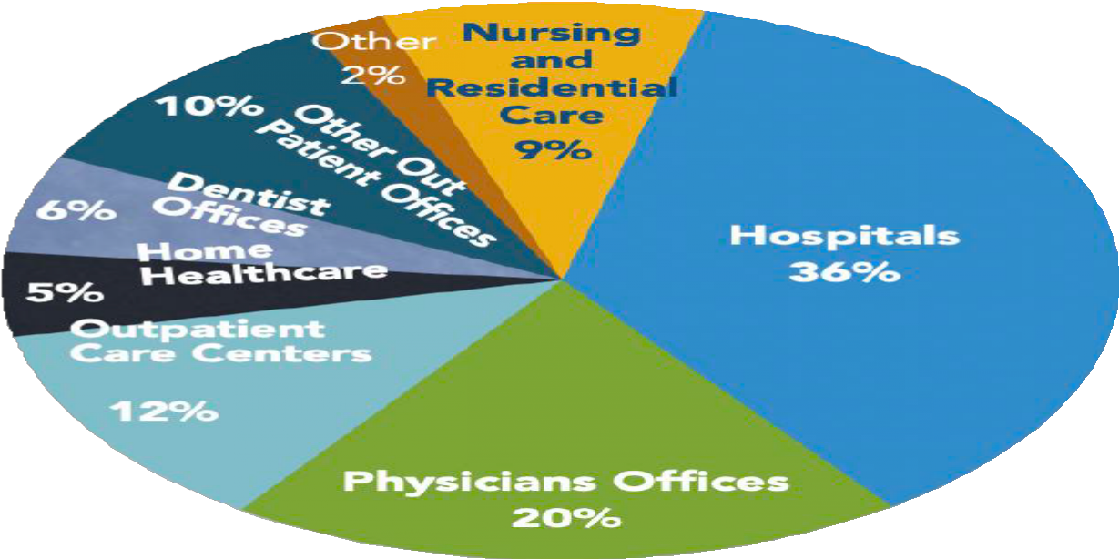
Alaska Healthcare Workforce & Earnings 2023
$3.4 Billion Workforce Earnings 44,310 Annualized Jobs

Slide 32
Top 8 Takeaways
Healthcare is Alaska’s top sector
Thousands of new hires needed annually
High Vacancy Rates
Healthcare Wages are Growing
Registered Nurses are #1 Need
Low % of Nonresidents in Healthcare Workforce
Most Healthcare Workers are Women
Most Healthcare Jobs & Wages in Alaska’s Hospitals

Slide 33
Thank You
Prepared by
Rain Coast Data

