Slide 1
Unintended Hypothermia: The Importance of Maintaining Normothermia
Hello Alaska
Cherrilyn Stati, MBA, BSN, RN
Perioperative Clinical Specialist

Slide 2
Disclosure
On-site or Virtual
Clinical Practice Assessments
Education
Formal Presentation
Product In-Service
Informal Storyboards
Product Skills Checklist
Product Evaluations
Product Implementations
Interactive/Brainstorming
Clinical studies
Evidenced-based guidelines
Clinical Ladder project
Super user development
Cherrilyn Stati, MBA, BSN, RN
Solventum Perioperative Clinical Specialist
Over 35 years of nursing experience
16 years Solventum Clinical Specialist
Focus on Surgical Site Infection Risk Reduction
Columbus, OH
cstati@solventum.com
812/363-3291
Notes:
Another nice feature of the system is that the optional cable may allow data to be transmitted from the temperature monitoring system to a compatible patient vital signs monitor. That information then may flow to a patient’s electronic medical record.
Patient Vital Signs Monitor - Celum ID: 1620863
EMR - Celum ID: 2001483
BHTM Monitor - Celum ID: 1276995

Slide 3
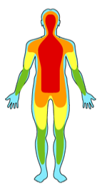
Unintended Perioperative Hypothermia Prevention
Core Temperature
Monitoring
Core temperature <36.0°C¹⁻³ (96.8ºF)
Unplanned Hypothermia during the perioperative process 50% - 90% of patients, unless treated¹⁻³
Considered, frequent, preventable complication of surgery¹⁻³
Adverse Effects
Thermoregulation
Causes
Prevention
The temperature of vital organs deep within the body, brain, spinal cord, protected by rib cage
Not peripheral temperature of the limbs, skin temperature
Single best indicator of thermal status¹
Noninvasive Core Temperature Monitor
Temperature Modality Accuracy with Invasiveness
Measure to Manage
Internal Use

Slide 4
Unplanned Perioperative Hypothermia
Negative outcomes of unplanned perioperative hypothermia
Perioperative hypothermia is defined as core temperature less than 36.0°C.¹⁻⁴
Research shows that even mild hypothermia can result in significant negative outcomes including:
Research shows that even mild hypothermia can result in significant negative outcomes including:
1,2
2
2,4
6,7
Kurz A, Sessler DI, Lenhard tR. Perioperative normothermia to reduce the incidence of surgical-wound infection and shorten hospitalization. NEJM. 1996 May 9;334(19): 1209-16.
Frank SM, Fleisher LA, Breslow MJ, etal. Perioperative maintenance of normothermia reduces the incidence of morbid cardiac events. A randomized clinical trial. JAMA. 1997; 277(14):1127-1134.
Scott AV, Stonemetz JL, Wasey JO, Johnson DJ, Rivers RJ, Koch CG, etal.(2015) Compliance with Surgical Care Improvement Project for Body Temperature Management (SCIP Inf-10) Is Associated with Improved Clinical Outcomes. Anesthesiology 123:116–125.
Anderson DJ. Strategies to prevent surgical site infections in acute care hospitals: 2014 update. Infection Control and Hospital Epidemiology .2014;35(6): 605–627. doi:10.1086/676022. Accessed December 15, 2016.
Melling AC, AliB, Scott EM, Leaper DJ. Eﬀects of preoperative warming on the incidence of wound infection after a clean surgery: a randomized controlled trial. Lancet. 2001; 358(9285):876-880.
Van Duren A. Patient Warming Plays a Signiﬁcant Role in Satisfaction, Clinical Outcomes. Infection Control Today. 2008;12(6):1-4 (reprint page numbers).
Rajagopalan S, etal. The Eﬀects of Mild Perioperative Hypothermia on Blood Loss and Transfusion Requirement. Anesth. 2008; 108:71-7.
Internal Use
Notes:
Hypothermia contributes to an increase in morbid myocardial events and ventricular tachycardia.
A study by Frank, published in The Journal of the American Medical Association, showed:
Increased rates of morbid cardiac events in hypothermic patients (6.3% versus 1.4% normothermic)
Increased postoperative ventricular tachycardia in hypothermic patients (7.9% versus 2.4% normothermic)
11. Frank SM, Fleisher LA, Breslow MJ, et al. Perioperative maintenance of normothermia reduces the incidence of morbid cardiac events. JAMA. 1997;347(8997):289-292.
Another adverse effect of unintended perioperative hypothermia is coagulopathy.
A study published in The Lancet indicates that blood loss is higher in hypothermic patients during surgery and postoperatively.¹²
Even a core temperature drop of <2°C was found to increase blood loss by 500mL (1 unit).¹²
A more recent meta-analysis published in Anesthesiology also found that mild hypothermia can increase blood loss.¹³
12. Schmied H, Kurz A, et al. Mild hypothermia increases blood loss and transfusion requirements during total hip arthroplasty. The Lancet. 1996;347(8997):289-292.
13. Rajagopalan S, et al. The Effects of Mild Perioperative Hypothermia on Blood Loss and Transfusion Requirement. Anesth. 2008; 108:71-7
In addition, in a group of 30 hypothermic patients, 8 units of allogeneic packed red blood cells were required by 7 of the patients as compared to only 1 normothermic patient, out of a group of 30 normothermic patients, who required just one unit of allogeneic blood.
The increase of surgical blood loss may be due to hypothermia, which can impair platelet function, reduce clotting, and increase fibrinolysis.
12. Schmied H, Kurz A, et al. Mild hypothermia increases blood loss and transfusion requirements during total hip arthroplasty. The Lancet. 1996;347(8997):289-292.
14. Lenhardt R, Marker E, Goli V, et al. Mild Intraoperative Hypothermia Prolongs Postanesthetic Recovery. Anesth. 1997; 87(6):1318-1323.
The fourth adverse effect of unintended intraoperative hypothermia is the altered action of many drugs commonly used in surgery.
Neuromuscular blocking agents, such as vecuronium, are a nondepolarizing muscle relaxant with a relatively short, predictable half life. Vecuronium’s average duration of action in a warm patient is 28±4 minutes. Research shows that when a patient’s body temperature drops to 34.3°C, the average acting duration of vecuronium more than doubles to 62±8 minutes.
Similarly, the drugs used to reverse vecuronium, such as neostigmine, are also affected by hypothermia.
15. Heier T, Caldwell JE, Sessler DI, et al. Mild Intraoperative Hypothermia Increases Duration of Action and Spontaneous Recovery of Vecuronium Blockade during Nitrous Oxide-Isoflurane Anesthesia in Humans. Anesth. 1991;74(5):815-819.
Another effect of unintended hypothermia is the severe discomfort experienced by patients, especially when shivering.
Shivering occurs in approximately 40-60% of all unwarmed patients recovering from general anesthesia.
Some patients have expressed the feelings of thermal discomfort and shivering to be more significant than post-surgical pain.
It is rare to see intense shivering postanesthetically in patients with normothermic temperatures.
3. Sessler DI. Current concepts: Mild Perioperative Hypothermia. New Engl J Med. 1997;336(24):1730-1737.
6. Sessler DI, Kurz A. Mild Perioperative Hypothermia. Anesthesiology News. October 2008: 17-28.
10. Kurz A, Sessler DI, et al. Perioperative Normothermia to Reduce the Incidence of Surgical-Wound Infection and Shorten Hospitalization. New Engl J Med. 1996;334:1209-1215.

Slide 5
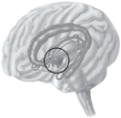
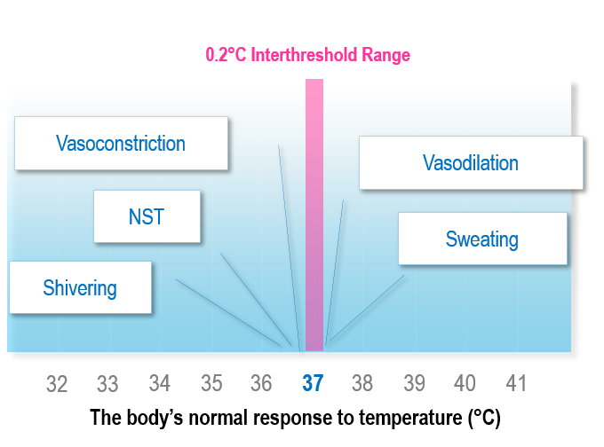
Normothermia
Normothermia: the body’s ideal thermal state
Normal core temperature:¹
Approximately 37.0°C (98.6°F)
Temperature gradient:¹
2-4°C between the core and periphery
Hypothalamus ^{1,2,3}
Regulates core body temperature
Hypothalamus
37ºC
Periphery
2-4ºC cooler
1. Sessler DI. Mild Perioperative Hypothermia. New Engl J Med. 1997;336(24):1730-1737.
2. Guyton AC, Hall JE. Textbook of Medical Physiology. 10th Ed. © 2000.
3. De Witte J, Sessler DI. Anesth. 2002;96(2):467-84.
Notes:
The body’s ideal temperature is approximately 37.0°C or 98.6°F in the core, the body cavity encompassing the vital organs and brain.
Under normal conditions, the body’s core temperature is 2-4°C warmer than the temperature of the periphery.
The hypothalamus, often referred to as the body’s thermostat, regulates the body’s core temperature. It receives information from thermoreceptors and compares it with threshold temperatures. If the sensed temperature is outside the interthreshold range, the hypothalamus triggers the appropriate thermoregulatory response.

Slide 6
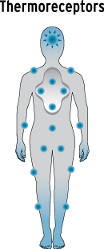
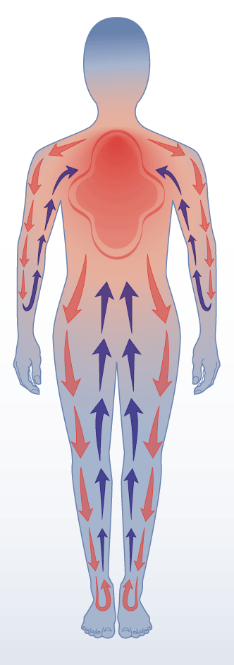
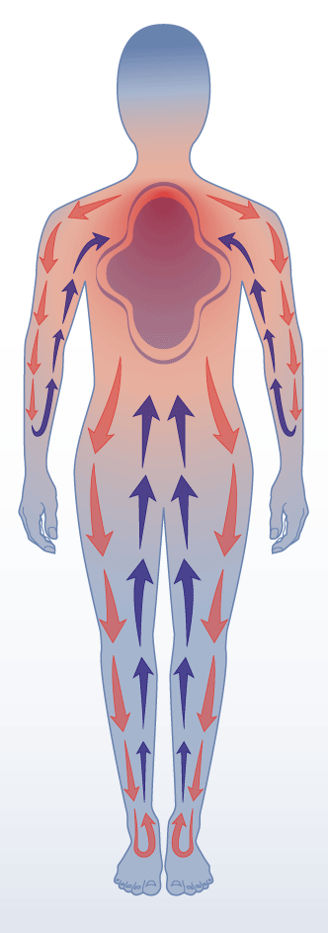
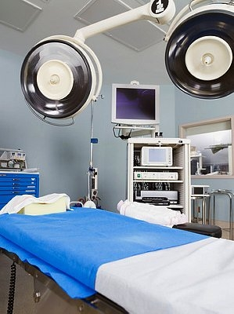
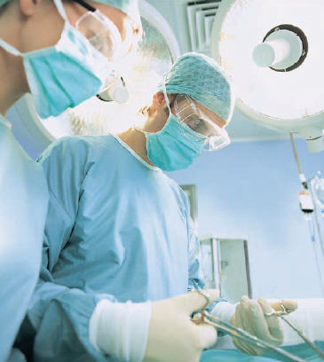
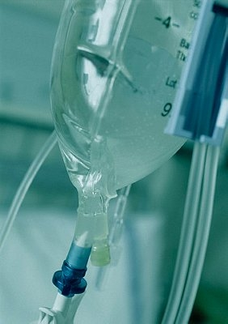
Thermoregulation under Anesthesia
81%
Hypothalamus Depressed
Incorrect perception of thermo-receptors
Core-to-Peripheral
4.0°C Interthreshold Range
Heat Redistribution
Vasoconstriction
Vasodilation
NST
Sweating
Hypothermia : < 36.0°C
32
33
34
35
36
37
38
39
40
41
Anesthesia-impaired response to temperature (°C)
Metabolic Heat Production Reduced
Exposed ^{1,2}
Cold OR ^{1,2}
Length of surgery^{1,2}
Cold wet preps
IV or Blood infusion
other

Slide 7
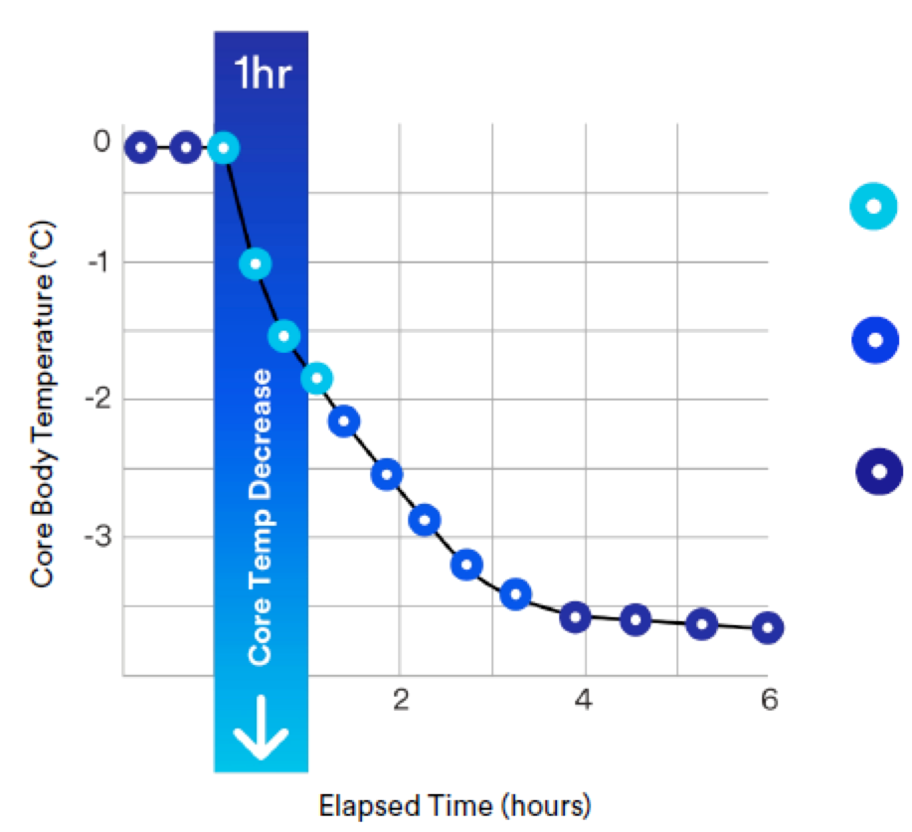
Characteristic Patterns of General Anesthesia-Induced Hypothermia¹
Core temperature can drop 1.6°C in the first hour of general anesthesia^{1,2}
Why? Anesthesia causes vasodilation allowing the warm blood from the core to flow freely and mix with the colder periphery
81% of this temperature decrease is due to core-to-peripheral heat redistribution caused by general anesthesia.²
RTD This is commonly known as redistribution temperature drop³
Phase 1
Rapid decrease in core temperature
Phase 2
Slow, linear decline in temperature
Phase 3
Temperature plateau
1. Sessler DI, McGuire J, Moayeri A, Hynson J. Isoflurane-induced vasodilation minimally increases cutaneous heat loss. Anesthesiology. 1991;74(2):226-232.
2. Matsukawa T, Sessler DI, Sessler AM, et al. Heat flow and distribution during induction of general anesthesia. Anesthesiology. 1995;82(3):662-673.
3. Sessler DI, Ponte J. Hypothermia during epidural anesthesia results mostly from redistribution of heat within the body, not heat loss to the environment. Anesthesiology. 1989;71 Suppl(3A):882.
4. Kurz A, Sessler DI, Christensen R, Dechert M. Heat balance and distribution during the core-temperature plateau in anesthetized humans. Anesthesiology. 1995;83(3):491-499.
5. Sessler DI. Perioperative heat balance. Anesthesiology. 2000;92(2):578-596.
Graph Adapted from References 4 & 5

Slide 8
Prewarming
prior to the induction of anesthesia helps to maintain normothermia and mitigate the effects of heat redistribution.¹
Anesthesia
causes vasodilation allowing warmer blood from the core to move to the periphery
Prewarming
before surgery increases the peripheral temperature.
Prewarming in addition to intraoperative has been shown to be a best practice for preventing hypothermia.
1. Moayeri A, Hynson J, Sessler DI, McGuire J. Pre-induction skin-surface warming prevents redistribution hypothermia. Anesthesiology. 1991;75 Suppl(3A):A1004.

Slide 9
2020 Meta-analysis: Prewarming decreases SSI Risk
7 Prospective Randomized Controlled Trials ; 1086 Patients
Hypothermia:
important factor affecting SSI Risk
Prewarming could decrease the risk of SSI by 40%
Meta-analysis findings
hypothermia: significantly impacts SSI occurrence
30 minutes of prewarming as close to the surgical procedure as possible
FAW temperature set<43 °C
Mixed methods: FAW and Fluid Warming
“Preoperative warming is a convenient and economical means of maintaining normothermia, which can effectively reduce postoperative morbidity and mortality.”
Xuan-Qi Zheng, Jin-Feng Huang, Jia-Liang Lin, Dong Chen, Ai-Min Wu, Effects of preoperative warming on the occurrence of surgical site infection: A
systematic review and meta-analysis. International Journal of Surgery, Volume 77, May 2020, Pages 40-47, https://doi.org/10.1016/j.ijsu.2020.03.016
Internal Use
Notes:
All the included RCTs evaluated or mentioned the risk of SSI with the use of prewarming methods compared to controls.
Hypothermia has been identified as one of the important factors affecting surgical site infection [SSI]([24–26]); thus, the lower the body temperature, the higher the risk of SSI [15,27]. Prewarming could decrease the risk of SSI by 40%
The results of the present meta-analysis show that preoperative warming can reduce the rate of SSI occurrence.
MIX methods of FAW and Fluid warming( FAWntemperature set<43 °C and 30-min prewarming) before surgery benefited more from prewarming.
Preoperative warming is a convenient and economical means of maintaining normothermia, which can effectively reduce postoperative morbidity and mortality.
In our study, warming methods were found to have a significant impact on the occurrence of SSI.

Slide 10
2020 Meta-analysis Prewarming decreases SSI Risk
Study & year | Performed Year | Pt Enrolled case/control | Treatment groups | Surgery type & Surgical Procedure | Warming system | Prewarming time | Temp setting | Additional
Munday 2017 | 2015-2015 | 50(25/25 | Prewarming; Standard of care | Caesarean | Mix FAW and fluid warming | 20 minutes before surgery | 43 °C | NO
Lau 2017 | 2014-2015 | 200(99/101 | Prewarming; Standard of care | General, Gynecology, Orthopedics, Urology | FAW blankets | 30 minutes before surgery | 43 °C | NO
Yi 2018 | 2014 | 62 (30/32 | Passive warming, active warming | Open thoracic surgery and hip replacement | FAW blankets | 15-30 min before surgery | 44 °C | NO
Chebbout 2017 | 2014-2016 | 87(44/43 | Prewarming; standard of care | Elective caesarean | Mix FAW and fluid warming | after induction of anesthesia | 38 °C | NO
Chiang 2017 | 2009-2011 | 71(17/54 | Prewarming; standard of care | Infrainguinal bypass surgery FAW blankets | Prewarming; Standard of Care | 2 hours before induction of anesthesia | 38°C | NO
Kurz 1996 | 1993-1995 | 200(104/96 | Prewarming; standard of care | Colorectal Surgery | Mix method FAW and fluid warmer | At time of induction | 40°C | NO
Melling 2001 | 1999-2000 | 416(277/139 | Prewarming; standard of care | Clean Surgery(breastvaricose vein or hernia) | FAW blanket | 30 minutes before surgery | NR | NO
Xuan-Qi Zheng, Jin-Feng Huang, Jia-Liang Lin, Dong Chen, Ai-Min Wu, Effects of preoperative warming on the occurrence of surgical site infection: A systematic review and meta-analysis. International Journal of Surgery, Volume 77, May 2020, Pages 40-47, https://doi.org/10.1016/j.ijsu.2020.03.016
Internal Use

Slide 11
ERAS®-Compliant Normothermia Protocol Implementation
Continuous core-temperature monitoring throughout the perioperative journey (pre/intra/post-operatively)
Prewarming with convective air for at least 10 minutes
Reducing the time between the end of prewarming and the induction of anesthesia
Intra-Operative warming with convective air for cases with anticipated anesthesia durations ≥30 minutes
Fluid warming if more than 1L of IV fluid will be administered
In children, if > 30 mL/kg of fluid is administered, it should be warmed
Post-Operative warming until patients are normothermic (36°C – 37.5°C) and thermally comfortable
1. An Evidence-based Warming Protocol Compliant with the ERAS® Society Guidelines Recommendation for Perioperative Normothermia Version
Internal Use

Slide 12
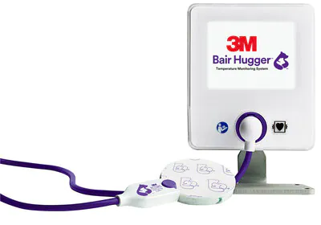
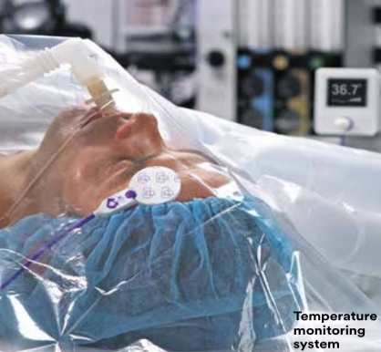
Bair HuggerTM Temperature Monitor
Measure to Manage
Non-invasive and accurate core temperature monitoring system that continuously measures temperature with a single-use sensor.
Rx Only. This product is intended to be used by trained medical professionals in a clinical/surgical setting.
Notes:
This system is a non-invasive and accurate way to continuously measure core temperature.
BHTM System Pic - Celum ID: 1276995

Slide 13
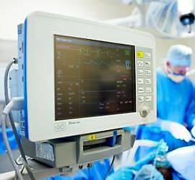
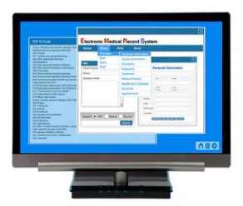
Bair HuggerTM Temperature Monitor
Temperature data may be continuously transmitted to a compatible patient vital signs monitor and electronic medical record.
3M™ Bair Hugger™ Temperature Monitoring System
Patient Vital Signs Monitor
EMR
Notes:
Another nice feature of the system is that the optional cable may allow data to be transmitted from the temperature monitoring system to a compatible patient vital signs monitor. That information then may flow to a patient’s electronic medical record.
Patient Vital Signs Monitor - Celum ID: 1620863
EMR - Celum ID: 2001483
BHTM Monitor - Celum ID: 1276995

Slide 14
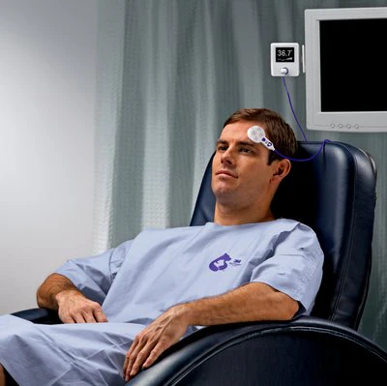
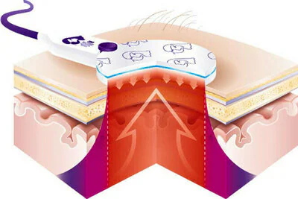
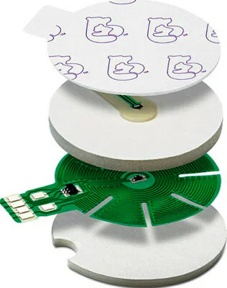
Bair HuggerTM Temperature Monitor
This image shows core temperature rising to the surface through an isothermal pathway.
ER
Pre-op
OR
PACU
ICU
Floor
Notes:
Simply stated, over several minutes, the isothermal pathway forms under the sensor, bringing the core temperature to the surface.
Skin & Sensor - Celum ID: 1886355

Slide 15
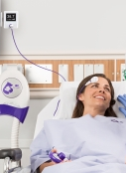
Prevent Unintended Perioperative Hypothermia Active Clinical Prewarming Options
Forced Air Warming
Patient Controlled
Pre and Postoperative settings
ICU, Procedural, Emergency Nursing floors
Not for Surgical Suite

Slide 16
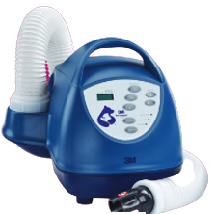
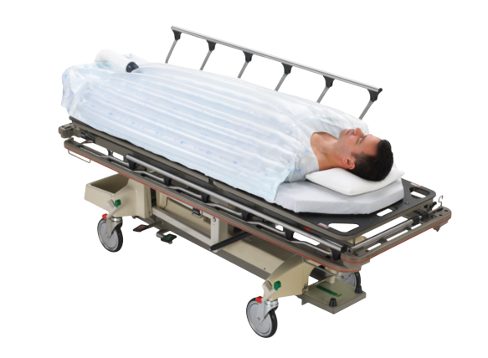
Prevent Unintended Perioperative Hypothermia Active Clinical Prewarming Options
Force Air Warming
Clinician controlled
Temperature assessment q 15 minutes
All hospital units
Filtration appropriate for OR

Slide 17
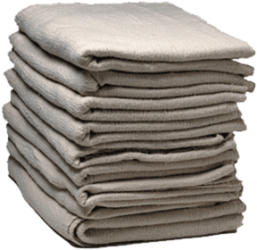
Cotton Blankets do not provide Clinical Prewarming
Cotton blankets do come with a cost.
Cotton blankets are passive insulators – they do not provide active warming¹
Heat from a warmed cotton blanket is quickly lost to its surroundings¹
Patient heat loss is virtually identical with warmed and unwarmed cotton blankets¹
$14.67
One Bair Hugger™ warming gown replaces the use of a cotton gown and nine cotton blankets³. At a cost of $1.63 the cost of cotton blankets makes up a majority of the direct product cost*.
Average cost of cotton blankets per surgical patient^{1,2}

Slide 18
Cost/Benefit Summary
Outcomes
Reducing the rate of hypothermia has been shown to reduce the risk of costly negative outcomes that include surgical site infections, myocardial events, and blood loss.¹⁻⁷
Product
Cotton is a large contributor in overall cost during a patient’s perioperative journey.
The Solventum™ Bair Hugger™ warming gown can help reduce the cotton use.
Time
Through standardization, eliminating unnecessary workflow steps, and having the patient enter the OR and PACU ready to be warmed, the Solventum™ Bair Hugger™ warming gown can help optimize the helps perioperative patient’s journey
Patient Satisfaction
Patient satisfaction has an impact on how a patient thinks, feels, and talks about their
care and can have an impact on which facility they choose.⁸
1. Schmied H, Reiter A, Kurz A, Sessler DI, Kozek S. Mild hypothermia increases blood loss and transfusion requirements during total hip arthroplasty. The Lancet. 1996 Feb 3;347(8997):289-92.
2. Kurz A, Sessler DI, Lenhardt R. Perioperative normothermia to reduce the incidence of surgical-wound infection and shorten hospitalization. NEJM. 1996 May 9;334(19):1209-16.
3. Melling AC, Ali B, Scott EM, Leaper DJ. Effects of preoperative warming on the incidence of wound infection after clean surgery: a randomised controlled trial. The Lancet. 2001 Sep 15;358(9285):876-80.
4. Frank SM, Fleisher LA, Breslow MJ, et al. Perioperative maintenance of normothermia reduces the incidence of morbid cardiac events. A randomized clinical trial. JAMA. 1997;277(14):1127-1134.
5. Scott AV, Stonemetz JL, Wasey JO, et al. Compliance with Surgical Care Improvement Project for Body Temperature Management (SCIP Inf-10) Is Associated with Improved Clinical Outcomes. Anesthesiology. 2015;123(1):116-125.
6. Kurz A, Sessler DI, Lenhardt R. Perioperative normothermia to reduce the incidence of surgical-wound infection and shorten hospitalization. NEJM. 1996 May 9;334(19):1209-16.
7. Scott AV, Stonemetz JL, Wasey JO, et al. Compliance with Surgical Care Improvement Project for Body Temperature Management (SCIP Inf-10) Is Associated with Improved Clinical Outcomes. Anesthesiology. 2015;123(1):116-125
8. Mckinsey & Company survery results. A Better Hospital Experience. The McKinsey Quarterly. Nov. 2007

Slide 19
Core Temperature Assessment: Measure to Manage
Prewarming: Prevent Unintended Perioperative Hypothermia
Prewarming Intraoperative Warming Normothermia
All Patients Benefit
--Longer: Anesthesia has time to rewarm
--Short: wake up when patient is coldest

Slide 20
Your Patient’s Recovery Starts in Pre-op What you do in pre-op changes outcomes!!

